Slide 1
SECTOR WORKSHOP
Part One
Current Custodians
Saturday 14 May 2016

Slide 2
AGENDA
TIME | TOPIC |  | AUDIENCE | TYPE |  | DURATION | PRESENTER
9.00 | Welcome and overview |  | Custodians | Presentation |  | 5 mins | Andrew Moritz
9.05 | Funding arrangements and IFAP |  | Custodians | Presentation |  | 10 mins | Andrew Moritz
9.15 | Custody management agreements |  | Custodians | Presentation and discussion |  | 30 mins | Andrew Moritz
9.45 | S2 funding proposals |  | Custodians | Presentation |  | 15 mins | Jennifer Edmonds
10.00 | Heritage impact statements and scopes of work |  | Custodians | Presentation |  | 15 mins | Jennifer Edmonds
10.15 | Work schedule |  | Custodians | Presentation |  | 15 mins | Jennifer Edmonds
10.30 | Expenditure table |  | Custodians | Presentation |  | 5 mins | Jennifer Edmonds
10.35 | MORNING TEA
11.00 | Template package | Custodians |  |  | Workshop | 50 mins | THNSW team
11.50 | Thank you and wrap up | Custodians |  |  | Presentation | 10 mins | Andrew Moritz
12.00 | LUNCH

Slide 3
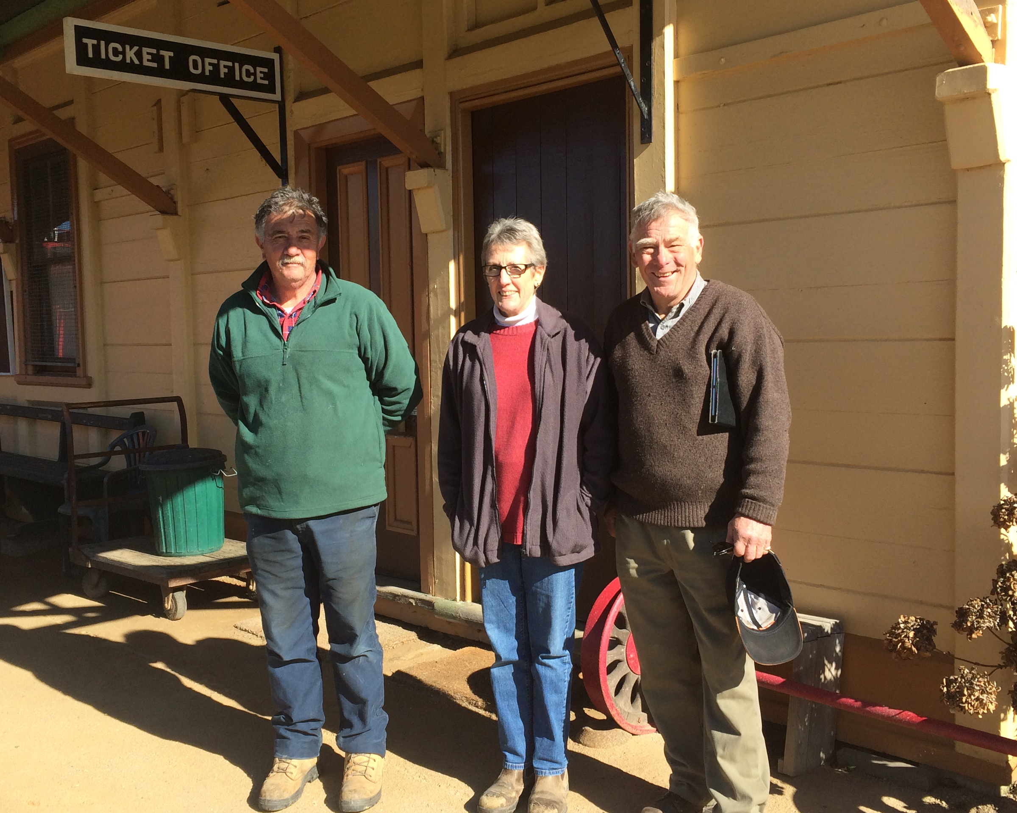
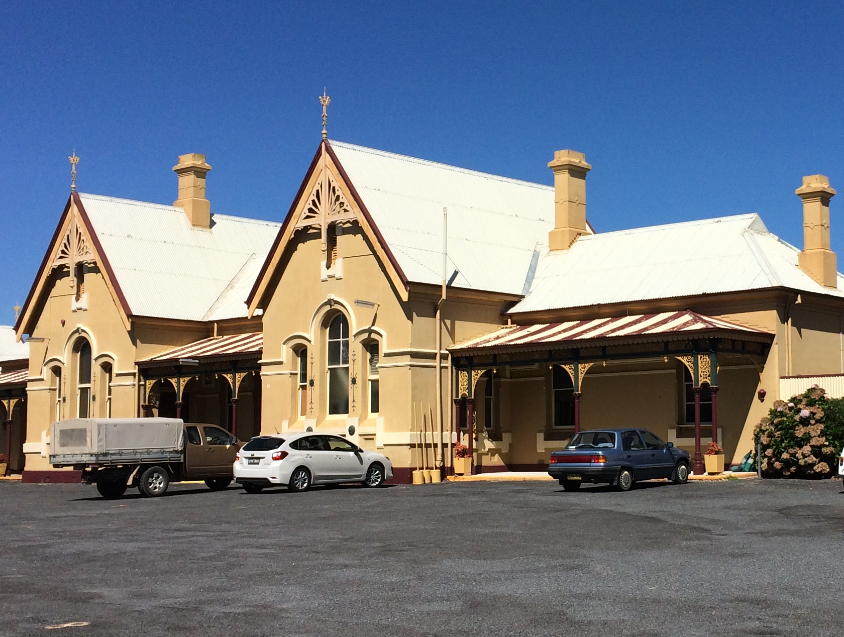
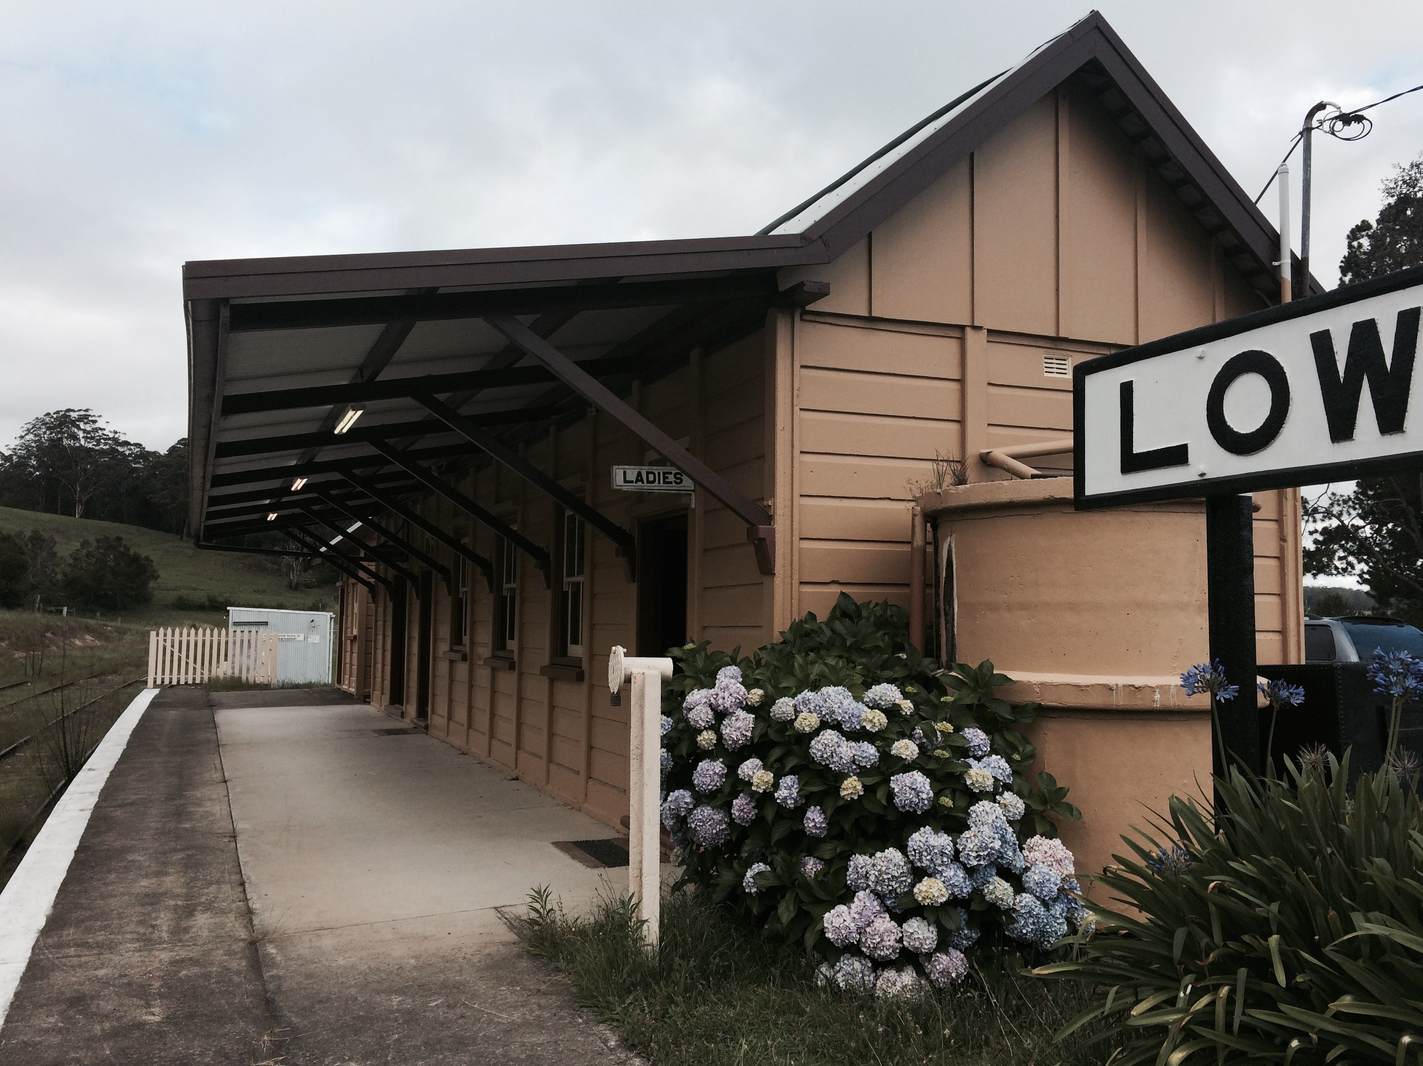
FUNDING ARRANGEMENTS
Stream 1 – operational funding assists THNSW to meet its obligations to manage the collections and engage with the sector.
Stream 2 – funding for State-owned assets, both allocated (to a custodian) or unallocated (in storage or untenanted). This funding is for major asset maintenance only, not ordinary day-to-day costs.
Stream 3 – funding for the grants program for non State-owned assets and projects and only available for projects where funding is not available elsewhere

Slide 4
INDEPENDENT FUNDING AND ADVISORY PANEL
  IFAP will ensure that decisions made about the heritage sector in NSW are made in a fair, transparent and impartial manner and in accordance with Government policies.
  Key functions:
    Review and endorse the Master Heritage Asset Management Plan prepared by THNSW
    Review and endorse the Consolidated Heritage Works Plan
    Review and endorse grants allocations under the Transport Heritage Grants Program
    Determine eligibility for government subsidies for National Rail Safety Regulator accreditation fees and Public Liability insurance
    Provide advice on any other existing or emerging issues relating to transport heritage in NSW

Slide 5
INDEPENDENT FUNDING AND ADVISORY PANEL
Christine Wright
Diane Leeson
Stuart Coppock
John Minchin

Slide 6
ROLES AND RESPONSIBILITIES
THNSW
Work with the sector to prepare funding submissions
Work with the sector to prepare loan/custody applications
IFAP
Consider and approve funding, taking into account heritage outcomes, funding available and value for money
Consider and approve loan/custody applications
Provide support to the sector in delivering funding projects
Provide advice to TfNSW
Enact IFAP decisions
Consider grants applications and determine S3 grants recipients

Slide 7
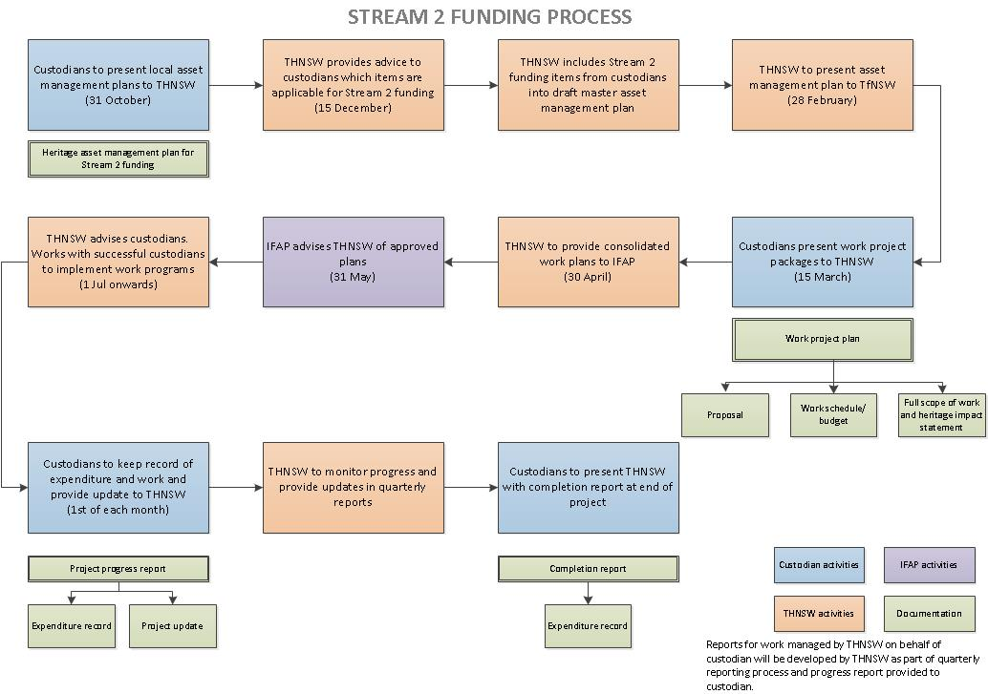
FUNDING PROCESS (in a normal year)

Slide 8
FUNDING TIMETABLE for this year only
DUE DATE | DELIVERABLE | RESPONSIBILITY
14/5/16 | Sector workshop – roll out of S2 arrangements to sector | THNSW
14/5/16 | S2 applications open for 2016/2017 financial year | THNSW
30/6/16 | S2 funding applications to be received from sector organisations | Sector organisations
July-Aug | Applications compiled and presented to IFAP | THNSW
September | IFAP approval of applications. | IFAP
September | Sector notified of approvals | THNSW
October | Work on approved projects commences | Sector organisations

Slide 9
CUSTODY MANAGEMENT AGREEMENTS
Purpose of agreements:
Ensure clarity – who is responsible for what
Ensure protection of objects and buildings
Ensure heritage significance is maintained
AGREEMENTS ARE APPROVED BY IFAP.

Slide 10
CUSTODY MANAGEMENT AGREEMENTS
AGREEMENTS
Fixed infrastructure
Movable objects

Slide 11
CUSTODY MANAGEMENT AGREEMENTS
INFRASTRUCTURE
Buildings
Grounds
Track
State-owned assets only (THNSW has no private infrastructure.) No new fixed infrastructure assets are available. Fixed infrastructure may be eligible for S2 funding, subject to IFAP approval.

Slide 12
CUSTODY MANAGEMENT AGREEMENTS/LOANS
MOVABLE OBJECTS
Display objects (rolling stock and small objects)
Operating objects (rolling stock, platform seats, ticket punches etc)
Spare parts
These types of agreements may be available for THNSW member-owned objects as well as State-owned objects. State-owned objects only may be eligible for S2 funding, subject to IFAP approval.

Slide 13
S2 FUNDING PROPOSALS
Work to be programmed ahead as part of the asset management plan. This is a living document that nevertheless tries to set out the expected major expenditure required to State-owned assets over a 10-year period.
Responsibility for providing information to go into each year’s asset management plan rests with the organisation who has direct responsibility for the assets. THNSW will provide support and assistance to develop these.
All S2 funding is approved by IFAP, and determined on merit of the project.
Emergency repairs for State-owned assets will be possible as out-of-course approvals.

Slide 14
TOTAL STATE-OWNED ITEMS
54
Heritage buildings
229
Items of rolling stock
3,798
Small movable objects

Slide 15
HERITAGE IMPACT STATEMENTS AND SCOPES OF WORK
PURPOSE:
To understand precisely what work is proposed for the object/building/precinct and exactly what the impact will be on the heritage fabric and significance.
To help IFAP make decisions about funding
To keep the records updated on the objects

Slide 16
HERITAGE IMPACT STATEMENTS AND SCOPES OF WORK
HIS is NOT required for:
day-to-day operational maintenance, such as changing brake shoes, sleepers or light bulbs, provided the changes are ‘like for like’.
HIS MIGHT be required for:
changing type of lighting used in building
re-sleepering heritage line if changing from timber sleepers to steel or concrete
HIS IS required for:
repainting building in different colour
carrying out work on rolling stock that is expected to change railway-made or fitted components or that is not like-for-like.

Slide 17
WORK SCHEDULE
This is similar to the work schedules previously prepared by custodians for Office of Rail Heritage funded work.
It is designed to ensure accurate estimates on the cost of the proposed work are developed and provided
It is designed to ensure IFAP can clearly understand what parts of a project funding is being requested for
It is designed to ensure custodians can include their own contribution, and the contribution of sponsors, grants and the local community, where applicable.

Slide 18
EXPENDITURE TABLE
Funds will be reimbursed on presentation of receipts to match the claim.
For large-scale, large-cost projects, invoices may be presented directly to THNSW for payment if so arranged prior.
To ensure transparency and good governance, custodians will need to provide evidence of their expenditure and show that the money has been used for the reasons it was approved.

Slide 19
MORNING TEA
Morning session resumes: 11.00am

Slide 20
TEMPLATE PACKAGE WORKSHOP
Workshop finishes 12.00pm

Slide 21
LUNCH
Afternoon session begins: 1.00PM

Slide 22
SECTOR WORKSHOP
Part Two
Aspiring Custodians and Grant Applications
Saturday 14 May 2016

Slide 23
AGENDA
1.00 | Welcome and overview | Custodians and sector | Presentation | 5 mins | Andrew Moritz
1.05 | RHA and ATHRA presentation | Custodians and sector | Presentation | 15 mins | Ross Jackson
1.20 | Applications for loan/custody agreements | Custodians and sector | Presentation | 15 mins | Jennifer Edmonds
1.50 | Loan/custody application workshop | Custodians and sector | Workshop | 30 mins | THNSW team
2.20 | Introduction to EMu/IMu | Custodians and sector | Presentation | 30 mins | Jennifer Edmonds
2.50 | AFTERNOON TEA
3.20 | Grants program | Custodians and sector | Workshop | 60 mins | RAHS
4.20 | Thank you and wrap up | Custodians and sector | Presentation | 10 mins | Andrew Moritz
4.30 | FINISH

Slide 24
INDEPENDENT FUNDING AND ADVISORY PANEL
Christine Wright
Diane Leeson
Stuart Coppock
John Minchin

Slide 25
ROLES AND RESPONSIBILITIES
THNSW
Work with the sector to prepare funding submissions
Work with the sector to prepare loan/custody applications
IFAP
Consider and approve funding, taking into account heritage outcomes, funding available and value for money
Consider and approve loan/custody applications
Provide support to the sector in delivering funding projects
Provide advice to TfNSW
Enact IFAP decisions
Consider grants applications and determine S3 grants recipients

Slide 26
LOAN/CUSTODY APPLICATIONS
A loan/custody application template has been developed to ensure:
Applicants understand the kind of information that is required
All applicants give the same information
As much supporting information is provided as possible at the beginning of the process
The applicant is given hints on how some of the questions might be answered

Slide 27
LOAN/CUSTODY APPLICATIONS
IFAP will have oversight of the loans process. For most small object loans, or for short-term loans, especially where security and object care can be managed by the applicant, it is likely that approval will be straightforward.
For rolling stock, long-term loans or objects that have a high level of interest (such as the model collection, where multiple applications have been received) IFAP will carry out a robust process to determine allocation.

Slide 28
LOAN APPLICATION WORKSHOP
Workshop finishes at 2.20pm

Slide 29
COLLECTION MANAGEMENT SYSTEM
PURPOSE
A single system to keep all information about collection items (including historical, maintenance records, capital project documentation)
A tool to help manage regular maintenance and inspection programs
A tool to manage location of collection items in stores, on display or on loan

Slide 30
COLLECTION MANAGEMENT SYSTEM
EMu (Electronic Museum)
Software has been in use for over twenty years and in use by major institutions including the Museum of Victoria, Powerhouse Museum and the Smithsonian – it has been tried and tested
It is based on museum standards
It includes modules that help us to track regular programmed maintenance, link data across entries, and include video and images
New licences can be purchased for organisations using the THNSW set up
Access is restricted and firewalled – each organisation can only see and change their own entries
It provides a portal for an online catalogue

Slide 31
ONLINE CATALOGUE
IMu (Internet Museum)
The publicly accessible online window into the collection
Allows a search to be carried out on THNSW’s website for collection objects
Allows museums and heritage organisations to browse collection objects in store and make considered applications for loans

Slide 32
AFTERNOON TEA
Afternoon session resumes: 3.20pm

Slide 33
GRANTS PROGRAM – ROYAL AUSTRALIAN HISTORICAL SOCIETY

Slide 34
WRAP UP AND FINISH

